Slide 1
No-Show Model Presentation
9/8/2021
Amanda Park

Slide 2
Overview of Data
110,522 observations
Appointment Date Range: 4/29/2016 to 6/8/2016
Goal: Predict probability of a patient no-showing to an appointment

Slide 3
Model Approach
Preprocess data to reduce noise in model
Fit a model using penalized LASSO logistic regression
Tuned penalty parameter in model using 5-fold cross-validation
Chose optimal model based on balanced accuracy
Notes:
balanced accuracy - arithmetic mean of sensitivity and specificity

Slide 4
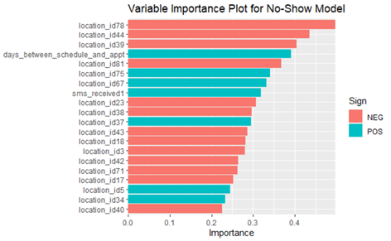
Findings
Model performed at 80% accuracy on both training and testing data, so did not overfit the data
Significant variables:
Days Between Scheduling and Appointment
Location ID
Some locations are associated with lower no-show rates, some higher
SMS Text Received

Slide 5
Recommendations
Flag the over 3000 patients that have repeatedly no-showed in the system as being high-risk to no-show again
Give them additional focus to ensure they arrive to their appointment (for example, a phone call reminder a week out as opposed to a text)
When feasible, reduce the percentage of patients requesting appointments far in advance
Experiment with the timing of text messages and when they are sent to patients. Right now over 43% of patients who no-show received a text message reminder.
Is the phone number accurate? How far out are text reminders sent? 1 day? 1 week? Ask these types of questions.

Slide 6
If I Had More Time…
Data Cleaning stuff:
Bucket days between schedule date and appointment date
Cluster location ID into fewer levels
Improve model accuracy through the following:
Fitting additional models such as a tree-based model like XGBoost
Create an ensemble of multiple models
If this wasn’t a canned data set…
Bring in additional Social Determinants of Health (SDOH) data such as Social Vulnerability Index, could give better understanding as to complexities of patient population

